Slide 1

ANGULAR JS
T-Systems Russia, Boris Finkelshteyn

Slide 2


Boris Finkelshteyn
T-systems Russia
Senior software developer
Boris.Finkelshteyn@t-systems.ru
yam.telekom.de/people/boris_finkelshteyn

Slide 3
Your skills
Входные параметры
HTML
JavaScript
CSS
IntelliJ IDEA
Tomcat
Выходные параметры
AngularJS(1.x) junior
Проект на AngularJS

Slide 4



Agenda
Forms and Models
overview
Directives
Tabs
Custom Directives
Directive Controllers
Dependencies
Services

Slide 5
Overview

Slide 6

Introduction
Angular JS– фреймворк для одностраничных веб-приложений
Основан на шаблоне MVC
Первый релиз – 2009
Лицензия MIT
Позволяет делать «отзывчивый» интерфейс (responsive)
Поддерживает TDD и BDD техники
Отделение DOM-манипуляции от логики приложения
Разделение клиентской и серверной стороны

Slide 7
Standard Web App
Web Server
Web Browser
URL Request to server
HTML
Java
Script
Response with Webpage & Assets
User clicks on link, new Request
HTML
Java
Script
Response with Webpage & Assets

Slide 8
Angular Web App
Web Server
Web Browser
URL Request to server
HTML
Java
Script
Response with Webpage & Assets
User clicks on link, new Request
DATA
Response with JSON data

Slide 9


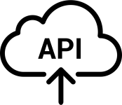


API-Driven Application
Data
Source

Slide 10
What is Angular JS?
Фреймворк для клиентской части вэб приложения, который добавляет интерактивность в HTML разметку.
HTML | JavaScript
<!DOCTYPE html> <html> <body> ... <body> </html> | function Hello() { alert(‘Hello!’); }
Index.html | app.js

Slide 11
Directives
Директива это маркер в HTML-теге, который говорит Ангуляру запустить или связать код на JavaScript.
HTML | JavaScript
<!DOCTYPE html> <html> <body ng-controller=“HelloController”> ... <body> </html> | function HelloController(){ alert(‘Hello!’); }
Index.html | app.js
Название функции, которую надо выполнить
Директива

Slide 12
Getting started
HTML
<!DOCTYPE html> <html> <head> <link rel=“stylesheet” type=“text/css” href=“bootstrap.min.css”> </head> <body> <script type=“text/javascript” src=“angular.min.js”></script> <body> </html>
Index.html
Twitter Bootstrap
Angular JS

Slide 13
Modules
Пишем в них части нашего приложения
Делают наш код более поддерживаемым, тестируемым и читабельным
В них мы определяем зависимости для нашего приложения
Модули могут использовать другие модули

Slide 14
Create module
JavaScript
var app = angular.module(‘store’, []);
app.js
Angular JS
Application Name
Dependencies

Slide 15
Including our module
<!DOCTYPE html> <html ng-app=“store”> <head> <link rel=“stylesheet” type=“text/css” href=“bootstrap.min.css”> <script type=“text/javascript” src=“angular.min.js”></script> <script type=“text/javascript” src=“app.js”></script> </head> <body> </body> </html> Index.html
var app = angular.module(‘store’, []); app.js
Запускает этот модуль, при загрузке документа

Slide 16
Expressions
Позволяют добавлять динамические значения в HTML
<p> I am {{4 + 6}} </p>
<p> I am 10 </p>
<p> {{“hello” + “ you”}} </p>
<p> hello you </p>

Slide 17
Expressions
<!DOCTYPE html> <html ng-app=“store”> <head> <link rel=“stylesheet” type=“text/css” href=“bootstrap.min.css”> </head> <body> <script type=“text/javascript” src=“angular.min.js”></script> <script type=“text/javascript” src=“app.js”></script> <p>{{“hello” + “ you”}}</p> <body> </html> Index.html
var app = angular.module(‘store’, []); app.js

Slide 18
Directives

Slide 19
Directives
ng-app – прикрепляет модуль приложения к странице
<html ng-app="store">
ng-controller – прикрепляет контроллер к странице
<body ng-controller="StoreController as store">
ng-show/ng-hide – показывает/скрывает секцию, основываясь на выражениях
<h1 ng-show="name"> Hello, {{name}}! </h1>
ng-repeat – повторяет секцию для каждого элемента в массиве
<li ng-repeat="product in store.products"> {{product.name}} </li>

Slide 20
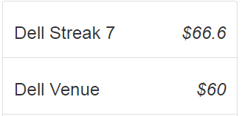
Code example
<body ng-controller="StoreController as store"> <ul class="list-group"> <li class="list-group-item" ng-repeat="product in store.products"> <h3> {{product.name}} <em class="pull-right">$ {{product.price}}</em> </h3> </li> </ul> </body> Index.html

Slide 21
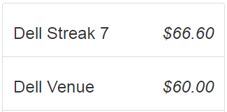
Filter
<body ng-controller="StoreController as store"> <ul class="list-group"> <li class="list-group-item" ng-repeat="product in store.products"> <h3> {{product.name}} <em class="pull-right">{{product.price | currency}}</em> </h3> </li> </ul> </body> Index.html
Форматирует в валюту
Переводит «вывод» на «вход»
Генерирует локализованный символ доллара
Добавляет цифры после точки

Slide 22
Filters
Общий вид
{{ data | filter:options}}
Date
{{'1388123412323' | date:'MM/dd/yyyy @ h:mma'}}
12/27/2013 @ 12:50AM
Uppercase & Lowercase
{{‘product name' | uppercase}}
PRODUCT NAME
LimitTo
{{'My Description' | limitTo:8}}
My Descr
<li ng-repeat="product in store.products | limitTo:3">
OrderBy
<li ng-repeat="product in store.products | orderBy:'-price'">

Slide 23
Image data
var products = [ { name: ‘First product', price: 2.95, description: '. . .', images: [ { full: ‘product-01-full.jpg', thumb: ‘product-01-thumb.jpg' }, { full: “product-02-full.jpg", . . . app.js
Для отображения первого изображения в массиве:
{{products.images[0].full}}

Slide 24
Ng-src for images
Нельзя использовать выражения Ангуляра внутри атрибута src
Браузер начнет загружать изображение до выполнения выражения Ангуляра
<img src="{{product.images[0].full}}"/>
<body ng-controller="StoreController as store"> <ul class="list-group"> <li class="list-group-item" ng-repeat="product in store.products"> <h3> {{product.name}} <em class="pull-right">{{product.price | currency}}</em> <img ng-src="{{product.images[0].full}}"/> </h3> </li> </ul> </body> Index.html

Slide 25
Tabs

Slide 26

Tabs
Motorola XOOM™ with Wi-Fi
Description
Specifications
Specifications
Reviews
Description
Specifications
Reviews
Specifications
RAM - 1000MB
Internal Storage - 32000MB
WiFi - 802.11 b/g/n
Description
Motorola XOOM with Wi-Fi has a super-powerful dual-core processor and Android™ 3.0 (Honeycomb).
Reviews

Slide 27
Tabs
<section> <ul class="nav nav-pills”> <li> <a href ng-click="tab = 1">Description</a> </li> <li> <a href ng-click="tab = 2">Specifications</a> </li> <li> <a href ng-click="tab = 3">Reviews</a> </li> </ul> {{tab}} </section> Index.html
Назначает значение для переменной tab
Description
Specifications
Reviews
Description
Motorola XOOM with Wi-Fi has a super-powerful dual-core processor and Android™ 3.0 (Honeycomb).
Выводит на экран значение переменной tab

Slide 28
Tabs
Motorola XOOM™ with Wi-Fi
Description
Specifications
Reviews
2
3
1

Slide 29
2-way data binding
Когда ng-click меняет значение переменной tab, то выражение {{tab}} автоматически обновляется.
Выражения Ангуляра определяют двухстороннее связывание(2-way Data Binding).
Это означает, что выражения Ангуляра изменяют значение когда само свойство изменяется.

Slide 30
Tab content panels
<li> <a href ng-click="tab = 3">Reviews</a> </li> </ul> {{tab}} </section> <div class="panel“> <h4>Description</h4> <p>{{product.description}}</p> </div> <div class="panel“> <h4>Specifications</h4> <p>{{product.specifications}}</p> </div> <div class="panel“> <h4>Reviews</h4> <p>None yet</p> </div> Index.html
Как же показывать нужную панель, при переключении

Slide 31
Trigger tabs
... <div class="panel“ ng-show=“tab === 1”> <h4>Description</h4> <p>{{product.description}}</p> </div> <div class="panel“ ng-show=“tab === 2”> <h4>Specifications</h4> <p>{{product.specifications}}</p> </div> <div class="panel“ ng-show=“tab === 3”> <h4>Reviews</h4> <p>None yet</p> </div> Index.html
Теперь при выборе вкладки будет показываться соответствующая панель

Slide 32
Trigger tabs
Motorola XOOM™ with Wi-Fi
Description
Specifications
Reviews
Specifications
RAM - 1000MB
Internal Storage - 32000MB
WiFi - 802.11 b/g/n
Reviews
None yet
Description
Motorola XOOM with Wi-Fi has a super-powerful dual-core processor and Android™ 3.0 (Honeycomb).
Description
Motorola XOOM with Wi-Fi has a super-powerful dual-core processor and Android™ 3.0 (Honeycomb).

Slide 33
No initial tab
Motorola XOOM™ with Wi-Fi
Description
Specifications
Reviews
Specifications
RAM - 1000MB
Internal Storage - 32000MB
WiFi - 802.11 b/g/n
Reviews
None yet
Description
Motorola XOOM with Wi-Fi has a super-powerful dual-core processor and Android™ 3.0 (Honeycomb).
Description
Motorola XOOM with Wi-Fi has a super-powerful dual-core processor and Android™ 3.0 (Honeycomb).

Slide 34
Setting initial value
Директива ng-init позволяет исполнять выражения Ангуляра в текущем скопе(область видиности)
<section ng-init=“tab = 1”> <ul class="nav nav-pills”> <li> <a href ng-click="tab = 1">Description</a> </li> <li> <a href ng-click="tab = 2">Specifications</a> </li> <li> <a href ng-click="tab = 3">Reviews</a> </li> </ul> ... Index.html

Slide 35
initial tab
Motorola XOOM™ with Wi-Fi
Description
Specifications
Reviews
Specifications
RAM - 1000MB
Internal Storage - 32000MB
WiFi - 802.11 b/g/n
Reviews
None yet
Description
Motorola XOOM with Wi-Fi has a super-powerful dual-core processor and Android™ 3.0 (Honeycomb).

Slide 36
Setting active tab
Нам нужно добавить класс «active» к выбранной вкладке
<section ng-init=“tab = 1”> <ul class="nav nav-pills”> <li ng-class="{ active:tab === 1 }"> <a href ng-click="tab = 1">Description</a> </li> <li ng-class="{ active:tab === 2 }"> <a href ng-click="tab = 2">Specifications</a> </li> <li ng-class="{ active:tab === 3 }"> <a href ng-click="tab = 3">Reviews</a> </li> </ul> ... Index.html
Название класса, который надо задать
Выражение для вычисления, если результат – true, то задать класс «active», если нет – то ничего не делать

Slide 37
With active class
Motorola XOOM™ with Wi-Fi
Description
Specifications
Specifications
Reviews
Description
Specifications
Reviews
Specifications
RAM - 1000MB
Internal Storage - 32000MB
WiFi - 802.11 b/g/n
Description
Motorola XOOM with Wi-Fi has a super-powerful dual-core processor and Android™ 3.0 (Honeycomb).
Reviews
None yet

Slide 38
Pull logic to controller
Вся наша логика находится в HTML
<section ng-init=“tab = 1” ng-controller="PanelController as panel“> <ul class="nav nav-pills”> <li ng-class="{ active:tab === 1 }"> <a href ng-click="tab = 1">Description</a> </li> <li ng-class="{ active:tab === 2 }"> <a href ng-click="tab = 2">Specifications</a> </li> <li ng-class="{ active:tab === 3 }"> <a href ng-click="tab = 3">Reviews</a> </li> </ul> <div class="panel" ng-show=“tab === 1”> <h4>Description </h4> <p>{{product.description}}</p> </div> ... Index.html
app.controller("PanelController", function(){ }); app.js

Slide 39
Pull logic to controller
<section ng-init=“tab = 1” ng-controller="PanelController as panel“> <ul class="nav nav-pills”> <li ng-class="{ active:tab === 1 }"> <a href ng-click="tab = 1">Description</a> </li> <li ng-class="{ active:tab === 2 }"> <a href ng-click="tab = 2">Specifications</a> </li> <li ng-class="{ active:tab === 3 }"> <a href ng-click="tab = 3">Reviews</a> </li> </ul> <div class="panel" ng-show=“tab === 1”> <h4>Description </h4> <p>{{product.description}}</p> </div> ... Index.html
app.controller("PanelController", function(){ this.tab = 1; }); app.js

Slide 40
Pull logic to controller
<section ng-controller="PanelController as panel“> <ul class="nav nav-pills”> <li ng-class="{ active:tab === 1 }"> <a href ng-click="tab = 1">Description</a> </li> <li ng-class="{ active:tab === 2 }"> <a href ng-click="tab = 2">Specifications</a> </li> <li ng-class="{ active:tab === 3 }"> <a href ng-click="tab = 3">Reviews</a> </li> </ul> ... Index.html
ng-click="panel.selectTab(1)">Description</a>
ng-click="panel.selectTab(2)">Specifications</a>
ng-click="panel.selectTab(3)">Reviews</a>
app.controller("PanelController", function(){ this.tab = 1; this.selectTab = function(setTab){ this.tab = setTab; }; }); app.js

Slide 41
Pull logic to controller
<section ng-controller="PanelController as panel“> <ul class="nav nav-pills”> <li ng-class="{ active:tab === 1 }"> <a href ng-click="panel.selectTab(1)">Description</a> </li> <li ng-class="{ active:tab === 2 }"> <a href ng-click="panel.selectTab(2)">Specifications</a> </li> <li ng-class="{ active:tab === 3 }"> <a href ng-click="panel.selectTab(2)">Reviews</a> </li> </ul> ... Index.html
ng-class="{ active:panel.isSelected(1) }">
ng-class="{ active:panel.isSelected(2) }">
ng-class="{ active:panel.isSelected(3) }">
app.controller("PanelController", function(){ this.tab = 1; this.selectTab = function(setTab){ this.tab = setTab; }; this.isSelected = function(checkTab){ return this.tab === checkTab; }; }); app.js

Slide 42
With logic in controller
Motorola XOOM™ with Wi-Fi
Description
Specifications
Specifications
Reviews
Description
Specifications
Reviews
Specifications
RAM - 1000MB
Internal Storage - 32000MB
WiFi - 802.11 b/g/n
Description
Motorola XOOM with Wi-Fi has a super-powerful dual-core processor and Android™ 3.0 (Honeycomb).
Reviews
None yet

Slide 43
Forms and Models

Slide 44
Add a Review
Motorola XOOM™ with Wi-Fi
Description
Specifications
Reviews
Reviews
5 Stars I bought a few weeks ago.
Basically - the most positive impression.
— joe@thomas.com
4 Stars The device is quite satisfied. With its functions copes.
— tim@hater.com

Slide 45
Add a review
Reviews
5 Stars I bought a few weeks ago.
Basically - the most positive impression.
— joe@thomas.com
4 Stars The device is quite satisfied. With its functions copes.
— tim@hater.com
Submit a Review
Rate the Product
Write a short review of the product
example@gmail.com
Submit Review

Slide 46
Adding reviews to our products
app.controller("StoreController", function(){ this.products = [ { name: ‘Motorola XOOM™ with Wi-Fi', price: 250.00, description: '. . .', images: [...], reviews: [ { stars: 5, body: “I bought a few weeks ago.Basically - the most…”, author: “joe@thomas.com” }, { stars: 4, body: “The device is quite satisfied. With its functions copes.”, author: “tim@hater.com” } . . . app.js

Slide 47
Looping over reviews in our tab
<body ng-controller="StoreController as store"> <ul class="list-group"> <li class="list-group-item" ng-repeat="product in store.products"> ... <div class="panel" ng-show="panel.isSelected(3)"> <h4> Reviews </h4> <blockquote ng-repeat="review in product.reviews"> <b>Stars: {{review.stars}}</b> {{review.body}} <cite>by: {{review.author}}</cite> </blockquote> </div> Index.html

Slide 48
How is it displaying?
Reviews
5 Stars I bought a few weeks ago.
Basically - the most positive impression.
4 Stars The device is quite satisfied. With its functions copes.
Как начать реализовывать форму отзыва?

Slide 49
Creating review form
<h4> Reviews </h4> <blockquote ng-repeat="review in product.reviews">...</blockquote> <form name="reviewForm"> <select> <option value="1">1 star</option> <option value="2">2 stars</option> . . . </select> <textarea></textarea> <label>by:</label> <input type="email" /> <input type="submit" value="Submit" /> </form> Index.html
Reviews
Submit a Review
Rate the Product
Write a short review of the product
example@gmail.com
Submit Review

Slide 50
Implementing live preview
<form name="reviewForm"> <blockquote> <b>Stars: {{review.stars}}</b> {{review.body}} <cite>by: {{review.author}}</cite> </blockquote> <select> <option value="1">1 star</option> <option value="2">2 stars</option> . . . </select> <textarea></textarea> <label>by:</label> <input type="email" /> <input type="submit" value="Submit" /> </form> Index.html
Как нам связать объект review с объектами на форме?

Slide 51
Ng-model directive
<form name="reviewForm"> <blockquote> <b>Stars: {{review.stars}}</b> {{review.body}} <cite>by: {{review.author}}</cite> </blockquote> <select ng-model="review.stars"> <option value="1">1 star</option> <option value="2">2 stars</option> . . . </select> <textarea ng-model="review.body"></textarea> <label>by:</label> <input ng-model="review.author" type="email" /> <input type="submit" value="Submit" /> </form> Index.html

Slide 52
Live preview in action
Reviews
5 Stars I bought a few weeks ago.
— joe@thomas.com
Но как на самом деле мы добавляем новый отзыв?
Submit a Review
5
I bought a few weeks ago.
joe@thomas.com
Submit Review

Slide 53
Two More Binding Examples
With a Checkbox
<input ng-model="review.terms" type="checkbox" /> I agree to the terms
Задает значение true или false
With Radio Buttons
What color would you like? <input ng-model="review.color" type="radio" value="red" /> Red <input ng-model="review.color" type="radio" value="blue" /> Blue <input ng-model="review.color" type="radio" value="green" /> Green
Задает значение, которое было выбрано

Slide 54
Initialize the Review
<form name="reviewForm"> <b>Stars: {{review.stars}}</b> {{review.body}} <cite>by: {{review.author}}</cite> </blockquote> <blockquote> <select ng-model="review.stars"> <option value="1">1 star</option> <option value="2">2 stars</option> . . . </select> <textarea ng-model="review.body"></textarea> <label>by:</label> <input ng-model="review.author" type="email" /> <input type="submit" value="Submit" /> </form>
Нужно инициализировать review.
Мы можем использовать ng-init, но лучше это делать в контроллере.

Slide 55
Creating the Review Controller
app.controller("ReviewController", function(){ this.review = {}; }); app.js
<form name="reviewForm" ng-controller="ReviewController as reviewCtrl"> <blockquote> <b>Stars: {{review.stars}}</b> {{review.body}} <cite>by: {{review.author}}</cite> </blockquote> <select ng-model="review.stars"> <option value="1">1 star</option> <option value="2">2 stars</option> ... </select> <textarea ng-model="review.body"></textarea> Index.html
Нужно обновить все выражения Ангуляра, чтобы они использовали контроллер

Slide 56
Using the reviewCtrl.review
app.controller("ReviewController", function(){ this.review = {}; }); app.js
<form name="reviewForm" ng-controller="ReviewController as reviewCtrl"> <blockquote> <b>Stars: {{reviewCtrl.review.stars}}</b> {{reviewCtrl.review.body}} <cite>by: {{reviewCtrl.review.author}}</cite> </blockquote> <select ng-model="reviewCtrl.review.stars"> <option value="1">1 star</option> <option value="2">2 stars</option> ... </select> <textarea ng-model="reviewCtrl.review.body"></textarea> Index.html

Slide 57
Using ng-submit to make the Form Work
app.controller("ReviewController", function(){ this.review = {}; this.addReview = function(product) { product.reviews.push(this.review); }; }); app.js
ng-submit позволяет нам вызвать функцию когда форма отправляется
<form name="reviewForm" ng-controller="ReviewController as reviewCtrl" ng-submit="reviewCtrl.addReview(product)"> <blockquote> <b>Stars: {{reviewCtrl.review.stars}}</b> {{reviewCtrl.review.body}} <cite>by: {{reviewCtrl.review.author}}</cite> </blockquote> Index.html
Нам нужно определить эту функцию

Slide 58
Need clean form
Reviews
5 Stars I bought a few weeks ago.
— joe@thomas.com
Submit a Review
5
I bought a few weeks ago.
joe@thomas.com
Submit Review

Slide 59
Resetting the Form on Submit
app.controller("ReviewController", function(){ this.review = {}; this.addReview = function(product) { product.reviews.push(this.review); this.review = {}; }; }); app.js
<form name="reviewForm" ng-controller="ReviewController as reviewCtrl" ng-submit="reviewCtrl.addReview(product)"> <blockquote> <b>Stars: {{reviewCtrl.review.stars}}</b> {{reviewCtrl.review.body}} <cite>by: {{reviewCtrl.review.author}}</cite> </blockquote> Index.html

Slide 60
Form with reset
Reviews
5 Stars I bought a few weeks ago.
— joe@thomas.com
Если мы перезагрузим страницу в браузере, то все наши изменения пропадут, т.к. мы нигде их не сохраняем, например на сервере.
Submit a Review
5
I bought a few weeks ago.
joe@thomas.com
Submit Review

Slide 61
What about validations?
У Ангуляра есть много отличных валидаций на клиентской стороне, которые мы можем использовать вместе с нашими директивами.

Slide 62
Now with validation
Выключает стандартную HTML валидацию
<form name="reviewForm" ng-controller="ReviewController as reviewCtrl" ng-submit="reviewCtrl.addReview(product)" novalidate> <select ng-model="reviewCtrl.review.stars" required> <option value="1">1 star</option> ... </select> <textarea name="body" ng-model="reviewCtrl.review.body" required></textarea> <label>by:</label> <input name="author" ng-model="reviewCtrl.review.author" type="email“ required/> <div> reviewForm is {{reviewForm.$valid}} </div> <input type="submit" value="Submit" /> </form> Index.html
Помечаем обязательные поля
Печатаем вадилацию формы

Slide 63
With validations
Reviews
5 Stars
— joe@thomas.com
Reviews
5 Stars I bought a few weeks ago.
— joe@thomas.com
Submit a Review
5
Но мы все ещё можем отправить эту форму, даже если она не валидна.
I bought a few weeks ago.
Write a short review of the product
joe@thomas.com
Submit Review
reviewForm is true
reviewForm is false

Slide 64
Preventing the Submit
<form name="reviewForm" ng-controller="ReviewController as reviewCtrl" ng-submit="reviewCtrl.addReview(product)" novalidate> Index.html
Мы хотим чтоб этот метод выполнялся только тогда, когда reviewForm.$valid - true

Slide 65
Preventing the Submit
<form name="reviewForm" ng-controller="ReviewController as reviewCtrl" ng-submit="reviewForm.$valid && reviewCtrl.addReview(product)" novalidate> Index.html
Если $valid – false, то метод addReview не вызовется.

Slide 66
Doesn’t Submit an Invalid Form
Reviews
4 Stars The device is quite satisfied. With its functions copes.
— tim@hater.com
5 Stars I bought a few weeks ago.
— joe@thomas.com
Reviews
4 Stars The device is quite satisfied. With its functions copes.
— tim@hater.com
5 Stars
— joe@thomas.com
Как же нам сообщить пользователю что его форма не валидна?
Submit a Review
5
I bought a few weeks ago.
Write a short review of the product
joe@thomas.com
Submit Review
reviewForm is true
reviewForm is false

Slide 67
The Input Classes
<input name="author" ng-model="reviewCtrl.review.author" type="email" required />
Source before typing email
<input name="author" . . . class="ng-pristine ng-invalid">
Source after typing, with invalid email
<input name="author". . . class="ng-dirty ng-invalid">
Source after typing, with valid email
<input name="author" . . . class="ng-dirty ng-valid">
Так что давайте выделять поле на форме, используя классы, после того, как мы начали печатать – ng-girty, показывать валидно поле или нет – ng-valid, ng-invalid

Slide 68
CSS Classes
<input name="author" ng-model="reviewCtrl.review.author" type="email" required /> Index.html
.ng-invalid.ng-dirty { border-color: #FA787E; } .ng-valid.ng-dirty { border-color: #78FA89; } style.css
Красная граница для невалидного
Зеленая граница для валидного

Slide 69
Now with red and green borders!
Reviews
4 Stars The device is quite satisfied. With its functions copes.
— tim@hater.com
5 Stars I bought a few weeks ago.
— joe@thomas.com
Reviews
4 Stars The device is quite satisfied. With its functions copes.
— tim@hater.com
5 Stars
— joe@thomas.com
Submit a Review
5
Write a short review of the product
I bought a few weeks ago.
joe@thomas.com
Submit Review
reviewForm is true
reviewForm is false

Slide 70
HTML5-based type validations
Формы обычно имеют правила о корректных данных для полей ввода
AngularJS имеет встроенные валидаторы для распространённых типов полей ввода
<input type="email" name="email">
<input type="url" name="homepage">
<input type="number" name="quantity">
Так же можно определить длину строки
min=1 max=10

Slide 71
Custom Directives

Slide 72
Refactoring our code
<ul class="list-group"> <li class="list-group-item" ng-repeat="product in store.products"> <h3> {{product.name}} <em class="pull-right">${{product.price}}</em> </h3> <section ng-controller="PanelController as panel"> . . . Index.html
У нас будет множество страниц, которым нужно будет переиспользовать этот код
Как мы можем избежать дублирования кода?

Slide 73
Using ng-include for Templates
<ul class="list-group"> <li class="list-group-item" ng-repeat="product in store.products"> <h3 ng-include="'product-title.html'"> </h3> <section ng-controller="PanelController as panel"> Index.html
ng-include ожидает переменную с именем файла.
Для передачи имени непосредственно как строки нужно использовать одинарные кавычки
{{product.name}} <em class="pull-right">${{product.price}}</em> product-title.html
<h3 ng-include="'product-title.html'" class="ng-scope"> <span class="ng-scope ng-binding">Awesome Multi-touch Keyboard</span> <em class="pull-right ng-scope ng-binding">$250.00</em> </h3> generated.html

Slide 74
With ng-include
Motorola XOOM™ with Wi-Fi $95.5
Description
Specifications
Specifications
Reviews
Description
Specifications
Reviews
Specifications
RAM - 1000MB
Internal Storage - 32000MB
WiFi - 802.11 b/g/n
Description
Motorola XOOM with Wi-Fi has a super-powerful dual-core processor and Android™ 3.0 (Honeycomb).
Reviews
None yet

Slide 75
Page loading differently
Web Server
Web Browser
URL Request to server
HTML
Java
Script
Response with Webpage & Assets
Browser loads up
Angular app
Fetches ng-included file
HTML
HTML Returned

Slide 76
Creating our First Custom Directive
Используя ng-include
<h3 ng-include="'product-title.html'"></h3>
Кастомная директива
<product-title></product-title>
Наш старый код и наша кастомная директива делают абсолютно одинаковые вещи.
Зачем же использовать кастомные директивы?

Slide 77
Why Directives?
Директивы позволяют нам писать HTML-код который описывает поведение, а не просто разметку нашего приложения.
<aside class="col-sm-3"> <book-cover></book-cover> <h4><book-rating></book-rating></h4> </aside> <div class="col-sm-9"> <h3><book-title></book-title></h3> <book-authors></book-authors> <book-review-text></book-review-text> <book-genres></book-genres> </div>
Вы ведь можете понять что делает этот код?

Slide 78
Writing Custom Directives
Директивы для шаблонов
определяют кастомный тэг или атрибут который раскрывается или заменяется
может содержать логику контроллера
Директивы так же могут быть использованы для:
содержания сложного UI
вызовов эвентов и регистрации эвент-хэндлеров
Переисползования общих компонентов

Slide 79
How to Build Custom Directives
<product-title></product-title> Index.html
app.directive('productTitle', function(){ return { //A configuration object defining how your directive will work }; }); app.js

Slide 80
How to Build Custom Directives
<product-title></product-title> Index.html
app.directive('productTitle', function(){ return { restrict: 'E', templateUrl: 'product-title.html' }; }); app.js
Тип диррективы (E - елемент)
генерируется
URL шаблона
<h3> {{product.name}} <em class="pull-right">$250.00</em> </h3> Index.html

Slide 81
With custom directive
Motorola XOOM™ with Wi-Fi $95.5
Description
Specifications
Specifications
Reviews
Description
Specifications
Reviews
Specifications
RAM - 1000MB
Internal Storage - 32000MB
WiFi - 802.11 b/g/n
Description
Motorola XOOM with Wi-Fi has a super-powerful dual-core processor and Android™ 3.0 (Honeycomb).
Reviews
None yet

Slide 82
Attribute vs Element Directives
Директива - элемент
<product-title></product-title>
Директива - атрибут
<h3 product-title></h3>
Следует использовать директиву-элемент для UI виджетов и директиву-атрибут для изменения поведения, например – подсказка.

Slide 83
Defining an Attribute Directive
<h3 product-title></h3> Index.html
app.directive('productTitle', function(){ return { restrict: ‘A', templateUrl: 'product-title.html' }; }); app.js
Тип диррективы (A - атрибут)
генерируется
URL шаблона
<h3> {{product.name}} <em class="pull-right">$250.00</em> </h3> Index.html

Slide 84
Directives allow you to write better HTML
Когда вы пишите динамическое веб-приложение, как вы думаете вы будете в состоянии понять функциональность, просто посмотрев на HTML-код?
Нет, не так ли?
Когда вы пишете приложение на Angular JS, вы должны быть в состоянии понять поведение сразу из HTML-кода.
И для этого вам нужно использовать кастомные директивы, чтобы писать выразительный и богатый HTML.

Slide 85
Directive Controllers

Slide 86
Reviewing our Directive
<h3> {{product.name}} <em class="pull-right">${{product.price}}</em> </h3> Index.html
Директива атрибут
<h3 product-title></h3>
Директива елемент
<h3> <product-title></product-title> </h3>

Slide 87
What if we need a Controller?
<section ng-controller="PanelController as panels> <ul class="nav nav-pills"> . . . </ul> <div class="panel" ng-show="panels.isSelected(1)"> . . . </div> <div class="panel" ng-show="panels.isSelected(2)"> . . . </div> <div class="panel" ng-show="panels.isSelected(3)"> . . . </div> </section> Index.html

Slide 88
First, extract the template...
ng-controller="PanelController as panels Index.html
<section> <ul class="nav nav-pills"> . . . </ul> <div class="panel" ng-show="panels.isSelected(1)"> . . . </div> <div class="panel" ng-show="panels.isSelected(2)"> . . . </div> <div class="panel" ng-show="panels.isSelected(3)"> . . . </div> </section> product-panels.html

Slide 89
First, extract the template...
<h3> <product-title> </h3> <product-panels ng-controller="PanelController as panels> . . . </product-panels> Index.html
<section> <ul class="nav nav-pills"> . . . </ul> <div class="panel" ng-show="panels.isSelected(1)"> . . . </div> <div class="panel" ng-show="panels.isSelected(2)"> . . . </div> <div class="panel" ng-show="panels.isSelected(3)"> . . . </div> </section> product-panels.html

Slide 90
Now write the Directive ...
<product-panels ng-controller="PanelController as panels> . . . </product-panels> Index.html
app.directive('productPanels', function(){ return { restrict: 'E', templateUrl: 'product-panels.html' }; }); app.js

Slide 91
What about the Controller?
<product-panels ng-controller="PanelController as panels> . . . </product-panels> Index.html
app.directive('productPanels', function(){ return { restrict: 'E', templateUrl: 'product-panels.html' }; app.controller('PanelController', function(){ . . . }); }); app.js
Для начала нам нужно перенести эту функциональность вовнутрь директивы

Slide 92
Moving the Controller Inside
<product-panels ng-controller="PanelController as panels> . . . </product-panels> Index.html
Затем перенести ссылку на контроллер
app.directive('productPanels', function(){ return { restrict: 'E', templateUrl: 'product-panels.html‘, controller:function(){ . . . } }; }); app.js

Slide 93
Need to Specify the Alias
<product-panels> . . . </product-panels> Index.html
app.directive('productPanels', function(){ return { restrict: 'E', templateUrl: 'product-panels.html‘, controller:function(){ . . . }, controllerAs: 'panels' }; }); app.js
Теперь это работает, используем panels как ссылку на контроллер

Slide 94
With Directive Controller
Motorola XOOM™ with Wi-Fi $95.5
Description
Specifications
Specifications
Reviews
Description
Specifications
Reviews
Specifications
RAM - 1000MB
Internal Storage - 32000MB
WiFi - 802.11 b/g/n
Description
Motorola XOOM with Wi-Fi has a super-powerful dual-core processor and Android™ 3.0 (Honeycomb).
Reviews
None yet

Slide 95
Dependencies

Slide 96
Need to refactor?
(function(){ var app = angular.module('store',[]); app.controller('StoreController', function(){ . . . }); app.directive('productTitle', function(){ . . . }); app.directive('productGallery', function(){ . . . }); app.directive('productPanels', function(){ . . . }); ... })(); app.js
Можем-ли мы это переработать?

Slide 97
Extract into a new file ... products.js
(function(){ var app = angular.module('store',[]); app.controller('StoreController', function(){ . . . }); ... })(); app.js
app.directive('productTitle', function(){ . . . }); app.directive('productGallery', function(){ . . . }); app.directive('productPanels', function(){ . . . }); products.js

Slide 98
Make a new Module
(function(){ var app = angular.module('store',[]); app.controller('StoreController', function(){ . . . }); ... })(); app.js
Определили новый модуль
Имя модуля
Можно использовать переменную app и там и там, так как она находится в разных областях видимости
(function(){ var app = angular.module('store-products', [ ]); app.directive('productTitle', function(){ . . . }); app.directive('productGallery', function(){ . . . }); app.directive('productPanels', function(){ . . . }); })(); products.js

Slide 99
Add it to the dependencies
store зависит от store-products
(function(){ var app = angular.module('store',['store-products']); app.controller('StoreController', function(){ . . . }); ... })(); app.js
Имя модуля
(function(){ var app = angular.module('store-products', [ ]); app.directive('productTitle', function(){ . . . }); app.directive('productGallery', function(){ . . . }); app.directive('productPanels', function(){ . . . }); })(); products.js

Slide 100
We’ll also need to include the file
<!DOCTYPE html> <html ng-app="store"> <head> . . . </head> <body ng-controller="StoreController as store"> . . . <script src="angular.js"></script> <script src="app.js"></script> <script src="products.js"></script> </body> </html> index.html

Slide 101
With two modules
Motorola XOOM™ with Wi-Fi $95.5
Description
Specifications
Specifications
Reviews
Description
Specifications
Reviews
Specifications
RAM - 1000MB
Internal Storage - 32000MB
WiFi - 802.11 b/g/n
Description
Motorola XOOM with Wi-Fi has a super-powerful dual-core processor and Android™ 3.0 (Honeycomb).
Reviews
None yet

Slide 102
Services

Slide 103
Does this feel strange?
(function(){ var app = angular.module('store', [ 'store-products' ]); app.controller('StoreController', function(){ this.products = [ { name: '. . .', price: 1.99, . . . }, { name: '. . .', price: 1.99, . . . }, { name: '. . .', price: 1.99, . . . }, . . . ]; . . . }); ... })(); app.js
Что все эти данные тут делают?
Куда мы можем это переместить?
Должны-ли мы получать эти данные через API?

Slide 104
How do we get that data?
(function(){ var app = angular.module('store', [ 'store-products' ]); app.controller('StoreController', function(){ this.products = ??? . . . }); ... })(); app.js
Как нам получить эти данные через API?
http://api.example.com/products.json
[ { name: '. . .', price: 1.99, . . . }, { name: '. . .', price: 1.99, . . . }, { name: '. . .', price: 1.99, . . . }, ... ]

Slide 105
We need a Service!
Сервисы дают контроллеру дополнительную функциональность:
Получать JSON с веб-сервиса с помощью $http
Писать сообщения в JavaScript консоль с помощью $log
Фильтровать массив с помощью $filter
Все встроенные сервисы начинаются с $

Slide 106
Introducing the $http Service!
$http сервис позволять делать асинхронные запросы к серверу
Используя $http как функцию с параметрами
$http({ method: 'GET', url: '/products.json' });
Или использовать сокращенный метод
$http.get('/products.json', { apiKey: 'myApiKey' });
Оба этих метода возвращают Promise-объект с .success() и .error()
Если мы скажем $http получить JSON, то результат будет автоматически декодирован в объекты и массивы JavaScript
И так, как же нам использовать это?

Slide 107
How does a Controller use a Service like $http?
Используем данный синтаксис для контроллера
app.controller('SomeController', [ '$http', function($http){ } ]);
Имя сервиса
Имя сервиса как аргумент
Если нужно больше одного
app.controller('SomeController', [ '$http', '$log', function($http, $log){ } ]);
Это и есть внедрение зависимостей!

Slide 108
HOW Angular DI works?
app.controller('SomeController', [ '$http', '$log', function($http, $log){ } ]);
Мне нужны
$http и $log
Angular Injector
$http
SomeController
$log
Контроллер инициализирован
Когда контроллер запущен
Когда ангуляр загружен – все сервисы зарегистрированы

Slide 109
Time for injection!
(function(){ var app = angular.module('store', [ 'store-products' ]); app.controller('StoreController', ['$http‘, function($http){ this.products = ??? }]); })(); app.js
StoreController нужен $http сервис
$http внедрен через аргумент
Что же теперь?

Slide 110
Let’s use our Service!
(function(){ var app = angular.module('store', [ 'store-products' ]); app.controller('StoreController', ['$http', function($http){ this.products = ??? $http.get('/products.json') }]); })(); app.js
Получаем данные из
products.json

Slide 111
Our Service will Return Data
(function(){ var app = angular.module('store', [ 'store-products' ]); app.controller('StoreController', ['$http‘, function($http){ this.products = ??? $http.get('/products.json').success(function(data){ ??? = data; }); }]); })(); app.js
$http возвращает Promise, так что success() вернет data
Куда нам нужно положить data?

Slide 112
Storing the Data for use in our Page
(function(){ var app = angular.module('store', [ 'store-products' ]); app.controller('StoreController', ['$http‘, function($http){ var store = this; $http.get('/products.json').success(function(data){ store.products = data; }); }]); })(); app.js
Нужна внутренняя переменная с ссылкой на сам контроллер
Теперь мы можем положить data в контроллер

Slide 113
Initialize Products to be a Blank Array
(function(){ var app = angular.module('store', [ 'store-products' ]); app.controller('StoreController', ['$http‘, function($http){ var store = this; store.products = [ ]; $http.get('/products.json').success(function(data){ store.products = data; }); }]); })(); app.js
Нам нужно проинициализировать products как пустой массив,
так как страница будет нарисована раньше чем мы получим данные из GET запроса

Slide 114
With Service
Motorola XOOM™ with Wi-Fi $95.5
Description
Specifications
Specifications
Reviews
Description
Specifications
Reviews
Specifications
RAM - 1000MB
Internal Storage - 32000MB
WiFi - 802.11 b/g/n
Description
Motorola XOOM with Wi-Fi has a super-powerful dual-core processor and Android™ 3.0 (Honeycomb).
Reviews
None yet

Slide 115
Additional $http functionality
В дополнение к get() запросам, $http может делать post(), put(), delete()
$http.post('/path/to/resource.json', { param: 'value' });
$http.delete('/path/to/resource.json');
Или любой другой HTTP метод, используя объект config
$http({ method: 'OPTIONS', url: '/path/to/resource.json' });
$http({ method: 'PATCH', url: '/path/to/resource.json' });
$http({ method: 'TRACE', url: '/path/to/resource.json' });

Slide 116
Bonus

Slide 117
AngularJS full environment

Slide 118
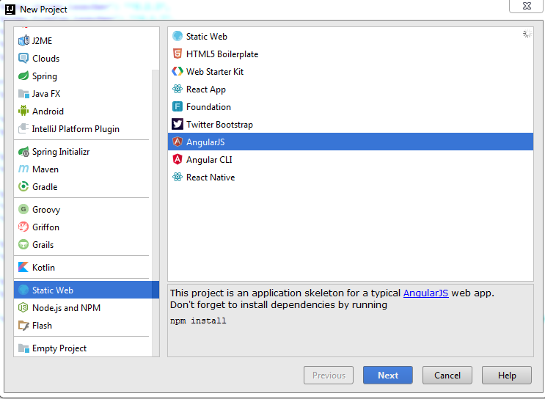
AngularJS full environment
Рассмотрим стандартное боевое окружение на примере проекта angular-seed.
Этот проект можно скачать тут - https://github.com/angular/angular-seed.git.
Или же его можно просто запустить из готового шаблона в IDEA.

Slide 119
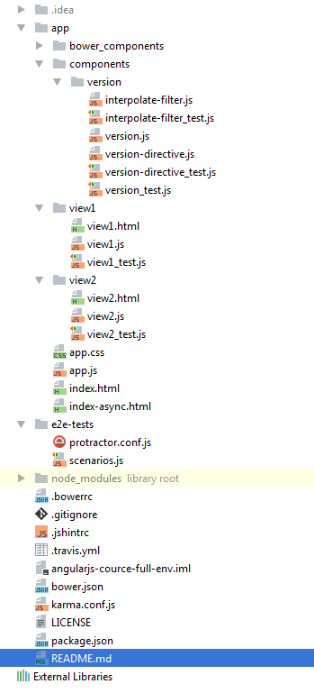
AngularJS full environment
Рассмотрим структуру полученного проекта
Как вы видите, на первый взгляд она достаточно сложна.
Попробуем разобраться, что же из себя представляет данный проект.

Slide 120
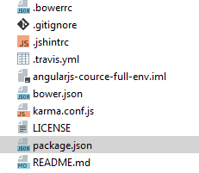
Package.json
Начнем с файла package.json
Файл package.json содержит в себе информацию о вашем приложении: название, версия, зависимости и тому подобное.
Любая директория, в которой есть этот файл, интерпретируется как Node.js-пакет, даже если вы не собираетесь публиковать его.

Slide 121

Node.js
Прежде чем рассматривать файл package.json, разберемся что такое node.js.
Сам по себе Node.js является C++ приложением, которое получает на входе JavaScript-код и выполняет его.
Node.js делает возможным написание серверных приложений на JavaScript. Он построен на движке JavaScript V8 и написан на C++.

Slide 122

NPM
Вкратце, пакетом в Node.js называется один или несколько JavaScript-файлов, представляющих собой какую-то библиотеку или инструмент.
npm (аббр. node package manager) — это стандартный менеджер пакетов, автоматически устанавливающийся вместе с Node.js. Он используется для скачивания пакетов из облачного сервера npm, либо для загрузки пакетов на эти сервера.
С помощью npm мы управляем пакетами, необходимыми в node.js для нашего проекта.
Например, мы хотим использовать http-server для разворачивания на нем нашего приложения.
Для этого надо сделать
npm install http-server

Slide 123
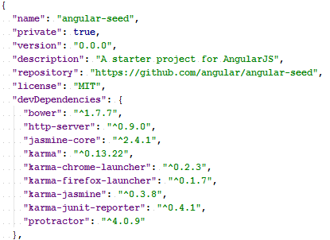
NPM and Package.json
Для того, чтобы не устанавливать вручную все зависимости для node.js в нашем проекте используется файл package.json.
Для выполнения этого файла достаточно перейти в директорию с этим файлом и написать
npm install

Slide 124
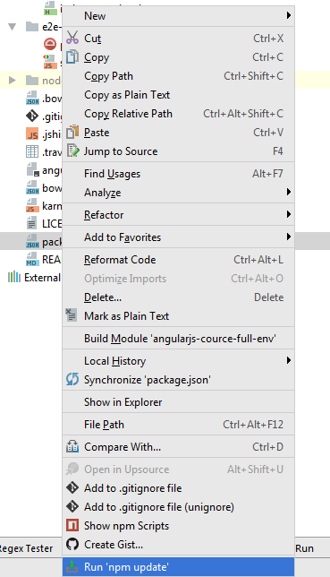
NPM and Package.json
В IDEA можно сделать таким образом(должен быть установлен плагин NodeJS)

Slide 125
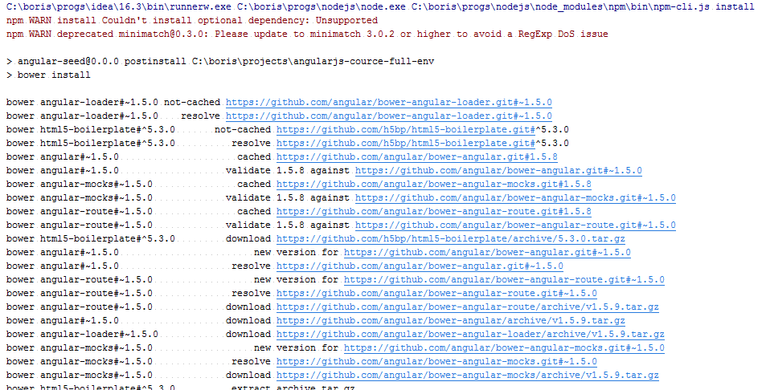
NPM and Package.json
Вывод консоли должен быть следующим

Slide 126
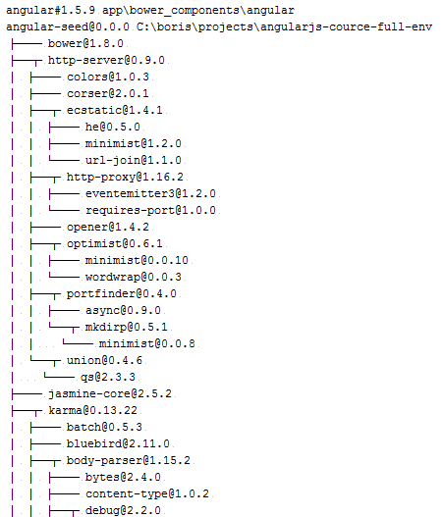
NPM and Package.json

Slide 127
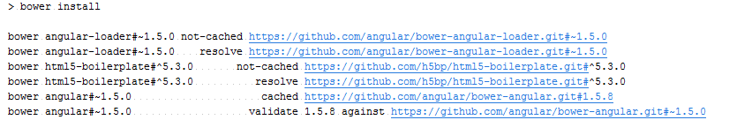
NPM and Package.json
Как вы могли заметить в выводе консоли были такие строчки
Хотя запускали мы npm, который должен был установить пакеты для node.js, а ангуляр это явно не пакет для node.js.

Slide 128
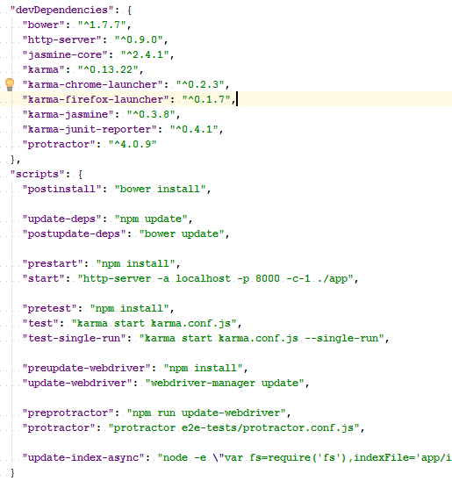
NPM and Package.json
Произошло это из-за того,
что в нашем package.json было написано следующее.
В секции skripts есть пункт postinstall и в нем мы выполняем bower install.
Прежде чем идти дальше, посмотрим, что такое bower.

Slide 129

Bower

Slide 130

Bower
Bower – это менеджер пакетов для нашего приложения.
Всё, что делает Bower — устанавливает нужные проекту пакеты подходящих версий вместе с их зависимостями.
Он загружает файлы нужных библиотек и всё, что нужно для их работы в специальную папку. Остальное остаётся на усмотрение разработчика.
Главное отличие npm и Bower — подход к установке зависимостей пакетов. npm устанавливает зависимости для каждого пакета отдельно, в итоге получается большое дерево пакетов (node_modules/grunt/node_modules/glob/node_modules/…), где может быть несколько версий одного и того же пакета.
В Бовере каждый пакет устанавливается один раз (jQuery всегда будет в папке bower_components/jquery, сколько бы пакетов от него не зависело) и в случае конфликта зависимостей, Бовер просто не станет устанавливать пакет, не совместимый с уже установленными.

Slide 131
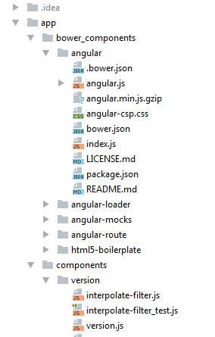
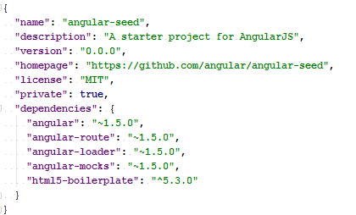
Bower and Bower.json
Bower складывает все наши зависимости на фронтенде в
папку bower_components.
Для bower как и для npm существует файл со списком зависимостей – bower.json

Slide 132
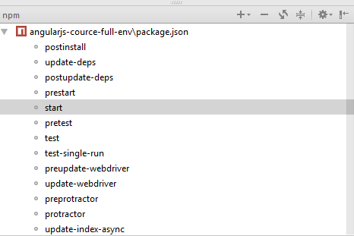
Run Application
Итого на данный момент мы запустили в корне нашего проекта
npm install
В результате этого в структуре нашего проекта появилось две новых директории
bower_components
node_modules
Для запуска приложения необходимо написать
npm start
Или же в IDEA можно сделать так:

Slide 133
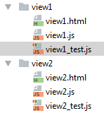
Testing
Теперь нам бы хотелось протестировать наш проект с помощью тестов.
В данном проекте есть фалы тестов лежат около самих js файлов, которые они тестируют, т.к. тут используется package by feature.
Данные тесты написаны с использованием фрейворка Jasmine.
Jasmine это BDD фреймворк (Behavior-Driven Development — Разработка на Основе Поведений) для тестирования JavaScript кода.

Slide 134
Jasmine
Основными ключевыми словами при работе с Jasmine являются:
describe — определение набора тестов, наборы могут быть вложенными
it — определение теста внутри любого набора тестов
expect — определяет ожидания, которые проверяются в тесте
describe "Набор тестов", -> it "проверка ожиданий", -> expect(1 + 2).toBe(3)

Slide 135

Karma
Karma это утилита для запуска тестов. Она умеет:
Запускать тесты из консоли
Автоматически прогонять все тесты при каждом сохранении
Возможность писать тесты на множестве фреймворков, таких как jasmine, mocha, qunit и др.
Прогонять тесты сразу на нескольких браузерах. (в том числе виртуальных, например fantomjs).

Slide 136
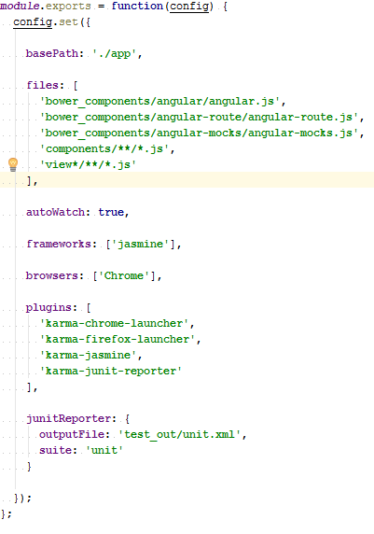
Karma
Для настройки Karma у нас есть файл karma.conf.js
Для запуска тестов необходимо написать
npm test
Это запустит Karma для выполнения тестов, Karma начнет отслеживать исходный для код для перезапуска тестов при изменении.
Можно запустить как единичный тест, который выполнится один раз.

Slide 137
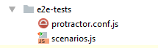
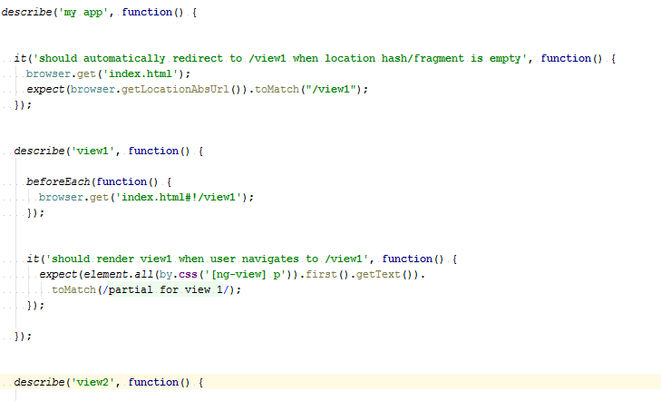
End-to-End Tests
В данном приложении присутствуют end-to-end тесты. Они написаны на Jasmine, но запускаются с помощью Protractor.
Файл scenarios.js содержит в себе описание тестов на Jasmine.

Slide 138

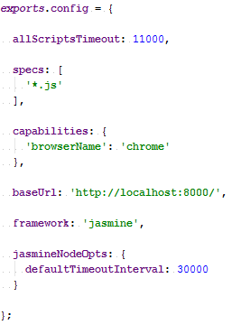
Protractor
Protractor: Инструмент функционального тестирования для AngularJS, который запускает ваше приложение в браузере и взаимодействует с ним через Selenium.
Конфигурационный файл protractor.conf.js
Выглядит следующим образом:

Slide 139
Run End-to-End Tests
Перед запуском Protractor нужно написать
npm start
Так как Protractor построен на WebDriver нужно убедиться что он обновлен.
Для этого нужно:
npm run update-webdriver
Теперь, когда наше приложение запущено можно стартовать e2e тесты:
npm run protractor

Slide 140
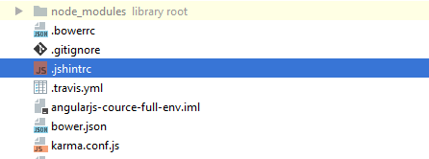
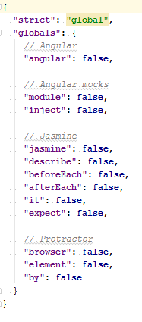
JSHINT
В проекте есть файл .jshintrc
Его содержание

Slide 141
JSHINT
JSHint — это анализатор кода, который укажет вам на ошибки в коде. Он совместим со многими широко используемыми текстовыми редакторами. Так же это хороший способ поддерживать стилистическое единство и целостность кода.
Есть встроенная поддержка в IDEA.

Slide 142
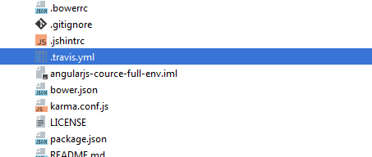
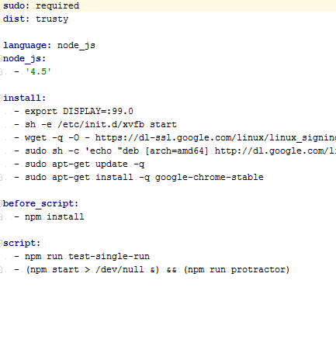
Travis CI
Travis CI это сервис непрерывной интеграции, который может мониторить GitHub и по комиту в репозиторий выполнять скрипты, такие как запуск приложения или запуск тестов.
Наш проет содержит конфигурационный файл Travis - .travis.yml, который настраивает Travis чтобы он запускал тесты, при заливке кода на GitHub.

Slide 143
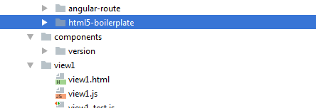
HTML5 Boilerplate
В проекте есть зависимость HTML5 Boilerplate
HTML5 Boilerplate — это HTML/CSS/JS шаблон для быстрого старта при разработке fron-end’а, который содержит в себе наилучшие готовые образцы, взятые из практики веб-разработки.
Содержит хаки для кросс-браузерной совместимости, настройки производительности и даже таких вещей, как кросс-домменых Ajax запросов и Flash.

Slide 144
AngularJS Security

Slide 145
Best practices
Оставаться на последней версии Ангуляра.
Не модифицировать свою копию Ангуляра.
Избегать использования API, помеченного в документации “Security Risk”

Slide 146
Preventing cross-site scripting (XSS)
Cross-site scripting (XSS) позволяет внедрить вредоносный код в веб-страницу. Подобный код, например, затем может похитить данные пользователя или работать от лица пользователя.
Чтобы заблокировать XSS атаки, необходимо предотвратить попадание вредоносного кода в DOM.
Например можно вставить код в тэг <script>. Но также можно выполнить код внутри многих элементов и свойствах.
<img onerror="..."> <a href="javascript:...">

Slide 147
Angular’s cross-site scripting
Если у злоумышленника есть доступ к управлению шаблонами и выражениями Ангуляра, то он может выполнять XSS атаки.
Есть несколько способов, как управлять шаблонами и выражениями:
Создавать шаблоны Ангуляра на сервере, содержащем контент, предоставленный пользователем.
Передавать выражение, генерируемое на основе ввода пользователя в вызовы следующих методов в скопе:
$watch(userContent, ...)
$watchGroup(userContent, ...)
$watchCollection(userContent, ...)
$eval(userContent)
$evalAsync(userContent)
$apply(userContent)
$applyAsync(userContent)

Slide 148
Angular’s cross-site scripting
Передавать выражение, генерируемое на основе ввода пользователя в вызовы следующих сервисов, которые парсят выражения:
$compile(userContent)
$parse(userContent)
$interpolate(userContent)
Передавать выражение, генерируемое на основе ввода как предикат в orderBy:
{{ value | orderBy : userContent }}

Slide 149
Server-side XSS protection
HTML сгенерированный на сервере подвержен для атак инъекций. Вставка такого шаблона в Ангуляр то же самое, что вставка такого исполняемого кода в приложение – это дает атакующему полный контроль над приложением.
Чтобы этого избежать используйте шаблонизатор, который автоматически экранирует значения для предотвращения XSS атак на сервере.

Slide 150
Strict Contextual Escaping
Strict Contextual Escaping (SCE) – это режим, в котором Ангуляр требует биндинга в определённых контекстах значения, которое помеченное как безопасное для использования в этом контексте.
Этот режим реализуется с помощью сервиса $sce и различных основных директив.
На пример, рендеринг произвольного контента с помощь директивы ngBindHtml.
Если контент поставляется пользователем, то есть шанс на Cross Site Scripting (XSS).
Директива ngBindHtml не будет отображать содержимое, не помеченное как безопасное в $sce.
Модуль ngSanitize может быть использован для отчистки и пометки такого контента предоставленного пользователем как безопасного.

Slide 151
HTTP-level vulnerabilities
Ангуляр имеет встроенную поддержку для предотвращения двух распространённых уязвимостей HTTP протокола - cross-site request forgery (CSRF or XSRF) и cross-site script inclusion (XSSI).
Обе этих уязвимостей в первую очередь должны быть предотвращены и настроены на сервере, но Ангуляр позволяет сделать эту интеграцию гораздо проще.

Slide 152
Cross-site request forgery(CSRF or XSRF)
В cross-site request forgery злоумышленник обманывает пользователя, посетившего страницу(например evil.com) с злокачественным кодом, который тайно посылает вредоносный запрос на вэб-сервер приложения(например example-bank.com).
Предположим пользователь вошел в приложение example-bank.com.
Затем пользователь открывает свою почту, нажимает на ссылку в письме, по которой открывается в новой вкладке сайт evil.com.
Сайт evil.com сразу же посылает запрос на example-bank.com. Это может быть запрос на перевод денег со счета пользователя на счет атакующего. При этом браузер автоматически посылает куки от example-bank.com с этим запросом.
Сервер example-bank.com, если на нем нет защиты от XSFR не может отличить легитимный запрос от не легитимный и выполняет его.

Slide 153
Cross-site request forgery(CSRF or XSRF)
Чтобы избежать этого, приложение должно гарантировать, что запрос пользователя происходит от реального приложения, а не с другого сайта. Сервер и клиент должны работать вместе, чтобы помешать этой атаке.
В общем случае техника anti-XSRF работает следующим образом – сервер отправляет ключ аутентификации, сгенерированный случайным образом в куки. Клиент читает куки и добавляет кастомный заголовок запроса с токеном во всех последующих запросах. Сервер сравнивает полученные куки с заголовком запроса и отклоняет запрос, если значение отсутствует или не совпадает друг другу.
Этот метод эффективен, так как все браузеры поддерживают одну и ту же политику. И только код с сайта, на котором установлены куки может читать куки с этого сайта и устанавливать кастомные заголовки запросов на этот сайт.
Это означает, что только ваше приложение может читать эти куки и устанавливать кастомный заголовок.

Slide 154
Cross-site request forgery(CSRF or XSRF)
Ангуляр имеет встроенную поддержку для выполнения этой техники на клиентской части как XSRFStrategy.
По умолчанию CookieXSRFStrategy включается автоматически.
Перед отправкой HTTP запроса, CookieXSRFStrategy ищет куки под названием XSRF-TOKEN и задает заголовок с именем X-XSRF-TOKEN со значением этого куки.
Сервер должен выполнить свою часть, установив начальное значение куки XSRF-TOKEN и подтвердить, что каждый последующий запрос, изменяющий состояние включает в себя куки XSRF-TOKEN и заголовок X-XSRF-TOKEN.
XSRF токен должен быть уникальным для каждого человека и сессии, иметь большое случайное значение, сгенерированное с помощью криптографически безопасного генератора случайных чисел и должен быть инвалидирован через день или два.

Slide 155
Cross-site script inclusion (XSSI)
Cross-site script inclusion, так же известная как JSON vulnerability может позволить злоумышленникам читать данные из JSON API.
Данная атака работает в старых браузерах, переопределяя нативный конструктор объектов JavaScript и затем включая API URL, используя тег <script>.
Эта атака будет успешна, только если возвращаемый объект это JSON, который является исполняемым в JavaScript. Серверы могут предотвратить такую атаку, добавив префикс для всех JSON ответов, сделав их не исполняемыми. По соглашению необходимо использовать строку - ")]}',\n".
Сервис $http распознает это соглашение и автоматически удаляет строку ")]}',\n" из всех ответов до последующего парсинга.
Немного информации можно подчерпнуть по этим ссылкам - https://security.googleblog.com/2011/05/website-security-for-webmasters.html
http://www.slideshare.net/carlo.bonamico/angularjs-security-defend-your-single-page-application
https://google-gruyere.appspot.com/

Slide 156
Popular mistakes

Slide 157
Folder structure like MVC applications
AngularJS является MVC фреймворком. Часто используемой практикой при использовании MVC фреймворков является группировка файлов по следующему шаблону:
templates/ _login.html _feed.html app/ app.js controllers/ LoginController.js FeedController.js directives/ FeedEntryDirective.js services/ LoginService.js FeedService.js filters/ CapatalizeFilter.js

Slide 158
Folder structure like MVC applications
Тем не менее при росте приложения использование подобной структуры папок приводит к тому, что в каждый момент времени приходится держать открытыми несколько папок. Поэтому при перемещении по дереву каталогов вы постоянно будете тратить время на скроллинг. Чтобы избежать этого, вы можете группировать файлы по функционалу, а не по типу:
app/ app.js Feed/ _feed.html FeedController.js FeedEntryDirective.js FeedService.js Login/ _login.html LoginController.js LoginService.js Shared/ CapatalizeFilter.js
Подобная структура папок делает гораздо более простым поиск связанных файлов, относящихся к одной и той же фиче, что способно ускорить процесс разработки. Да, это может показаться спорным — хранить в одной папке html файлы вместе с js, но эффект от экономии времени может оказаться более важным.

Slide 159
Modules (or lack thereof)
Часто, в начале разработки проекта весь функционал складывается в единый модуль. До какого-то момента подобный подход работает, но по мере развития проекта код становится неуправляемым.
var app = angular.module('app',[]); app.service('MyService', function(){ //service code }); app.controller('MyCtrl', function($scope, MyService){ //controller code });

Slide 160
Modules (or lack thereof)
Следующим по распространенности подходом является группировать объекты по их типу:
var services = angular.module('services',[]); services.service('MyService', function(){ //service code }); var controllers = angular.module('controllers',['services']); controllers.controller('MyCtrl', function($scope, MyService){ //controller code }); var app = angular.module('app',['controllers', 'services']);

Slide 161
Modules (or lack thereof)
Подобный подход масштабируется тоже не лучшим образом, подобно структуре каталогов по слоям. Чтобы добиться лучшей масштабируемости, мы последуем той же самой концепции разбиения кода по фичам:
var sharedServicesModule = angular.module('sharedServices',[]); sharedServices.service('NetworkService', function($http){}); var loginModule = angular.module('login',['sharedServices']); loginModule.service('loginService', function(NetworkService){}); loginModule.controller('loginCtrl', function($scope, loginService){}); var app = angular.module('app', ['sharedServices', 'login']);
Разнесение функционала по различным модулям также дает возможность повторного использования кода в различных проектах.

Slide 162
dependency injection
AngularJS очень гибок в вопросе того, как зависимости могут быть внедрены. Самый простой способ — это передать зависимость в функцию в качестве параметра:
var app = angular.module('app',[]); app.controller('MainCtrl', function($scope, $timeout){ $timeout(function(){ console.log($scope); }, 1000); });

Slide 163
dependency injection
Из кода ясно, что MainCtrl зависит от $scope and $timeout. Это прекрасно работает до того момента, как проект пойдет в продакшн и вы захотите минифицировать ваш код. Использование UglifyJS к вышеуказанному коду приведет к следующему:
var app=angular.module("app",[]);app.controller("MainCtrl",function(e,t){t(function(){console.log(e)},1e3)})
Теперь AngularJS никак не узнает от чего в реальности зависит MainCtrl.

Slide 164
dependency injection
Чтобы этого не происходило, есть очень простое решение — передавать зависимости как массив строк, с последним элементом в виде функции, принимающей все перечисленные зависимости в виде параметров:
app.controller('MainCtrl', ['$scope', '$timeout', function($scope, $timeout){ $timeout(function(){ console.log($scope); }, 1000); }]);
Код выше будет преобразован минификатором в код, который AngularJS уже сможет корректно интерпретировать:
app.controller("MainCtrl",["$scope","$timeout",function(e,t){t(function(){console.log(e)},1e3)}])

Slide 165
Global dependencies
Часто, при разработке AngularJS приложения, появляется необходимость в использовании объектов, доступных в любой точке приложения. Это ломает стройную модель, основанную на внедрении зависимостей, и приводит к возникновению багов и усложнению процесса тестирования. AngularJS позволяет оборачивать подобные объекты в модули так, что они могут быть внедрены подобно обычным AngularJS модулям. К примеру, великолепная библиотека Underscore.js может быть завернута в модуль следующим образом:

Slide 166
Global dependencies
var underscore = angular.module('underscore', []); underscore.factory('_', function() { return window._; //Underscore must already be loaded on the page }); var app = angular.module('app', ['underscore']); app.controller('MainCtrl', ['$scope', '_', function($scope, _) { init = function() { _.keys($scope); } init(); }]);
Это позволяет приложению использовать единый стиль с обязательным внедрением зависимостей и оставляет возможность тестировать модули в отрыве от функционала их зависимостей.

Slide 167
Inflating controllers
Контроллеры — это основа AngularJS. И часто, особенно новички, пишут в контроллерах слишком много логики. Контроллеры не должны осуществлять манипуляции с DOM или содержать DOM селекторы, для это существуют директивы.
Точно также и бизнес-логика должна находиться в сервисах. Данные также должны храниться в сервисах (за исключением случаев когда данные привязаны к $scope), поскольку сервисы, в отличие от контроллеров, синглтоны, чье время жизни совпадает со временем жизни самого приложения.
При разработке контроллеров лучше всего следовать принципу единственной ответственности (SRP) и считать контроллер координатором между представлением и моделью, в этом случае логики в нем будет минимум.

Slide 168
Service vs Factory
Эти именования приводят в конфуз каждого новичка в AngularJS, хотя в реальности они почти одинаковы. Посмотрим исходные коды AngularJS:
function factory(name, factoryFn) { return provider(name, { $get: factoryFn }); } function service(name, constructor) { return factory(name, ['$injector', function($injector) { return $injector.instantiate(constructor); }]); }
Функция service просто вызывает функцию factory, в которую обернут вызов функции provider. Если service просто вызывает функцию factory, в чем разница между ними? Смысл в $injector.instantiate, внутри которой $injector создает новый экземпляр функции конструктора сервиса.

Slide 169
Service vs Factory
Пример сервиса и фабрики, выполняющих одинаковые действия:
var app = angular.module('app',[]); app.service('helloWorldService', function(){ this.hello = function() { return "Hello World"; }; }); app.factory('helloWorldFactory', function(){ return { hello: function() { return "Hello World"; } } });
В момент, когда helloWorldService или helloWorldFactory будут инжектированы в контроллер, они обе будут иметь единственный метод, возвращающий «Hello World». Поскольку все провайдеры синглтоны, у нас всегда будет только один экземпляр сервиса и один экземпляр фабрики.

Slide 170
Service vs Factory
Так почему же существуют одновременно и фабрики и сервисы, если они выполняют одну и ту же функцию?
Фабрики предоставляют больше гибкости, поскольку они могут возвращать функцию, которая может создавать новые объекты.
В ООП фабрика представляет собой объект, создающий другие объекты:
app.factory('helloFactory', function() { return function(name) { this.name = name; this.hello = function() { return "Hello " + this.name; }; }; });

Slide 171
Service vs Factory
Вот пример контроллера, использующего сервис и две фабрики:
app.controller('helloCtrl', function($scope, helloWorldService, helloWorldFactory, helloFactory) { init = function() { helloWorldService.hello(); //'Hello World' helloWorldFactory.hello(); //'Hello World' new helloFactory('Readers').hello() //'Hello Readers' } init(); });

Slide 172
Service vs Factory
Фабрики также могут быть полезны при разработке классов с приватными методами:
app.factory('privateFactory', function(){ var privateFunc = function(name) { return name.split("").reverse().join(""); //reverses the name }; return { hello: function(name){ return "Hello " + privateFunc(name); } }; });

Slide 173
disuse Batarang
Batarang — это расширение браузера Chrome для разработки и дебага AngularJS приложений. Batarang позволяет:
просматривать модели привязанные к скоупам
строить граф зависимостей в приложении
производить анализ производительности приложения
Несмотря на то, что производительность AngularJS неплохая «из коробки», при росте приложения, с добавлением кастомных директив и сложной логики, приложение может начать подтормаживать.
Используя Batarang легко разобраться, какая из функций тратит много времени при вызове.
Batarang также отображает дерево наблюдателей (watch tree), которое может быть полезным при использовании большого числа наблюдателей (watchers).

Slide 174
Too many observers
Как было отмечено выше, AngularJS довольно производителен из коробки. Но, когда количество наблюдателей достигнет числа 2000, $digest цикл, в котором происходит проверка изменения данных, может начать замедлять работу приложения.
Хотя достижение числа 2000 не гарантирует замедления, это хорошая стартовая точка, с которой уже можно начинать беспокоиться.
С помощью батаранга и скриптов вы можете посмотреть, есть ли у вас наблюдатели-дубликаты или наблюдатели над неизменяемыми данными. В случае с неизменяемыми данными вы можете использовать директиву bindonce, чтобы не увеличивать количество наблюдателей на странице.

Slide 175
Scopes Inheritance ($scope's)
Наследование в JS основанное на прототипах отличается от классического наследования на классах. Обычно это не является проблемой, но эти нюансы могут проявляться при работе со скоупами. В AngularJS обычный (не изолированный) $scope наследован от родительского до самого старшего предка $rootScope.
<div ng-controller="navCtrl"> <span>{{user}}</span> <div ng-controller="loginCtrl"> <span>{{user}}</span> <input ng-model="user"></input> </div> </div>
Теперь вопрос: когда пользователь введет свое имя в текстовое поле, в каких элементах оно будет отображаться:navCtrl, loginCtrl, или в обоих?

Slide 176
Scopes Inheritance ($scope's)
Чтобы добиться желаемого поведения, нам желательно использовать объект для корректного обновления имени пользователя в дочернем и родительском $scope.
<div ng-controller="navCtrl"> <span>{{user.name}}</span> <div ng-controller="loginCtrl"> <span>{{user.name}}</span> <input ng-model="user.name"></input> </div> </div>

Slide 177
Using manual testing
До тех пока вы не начнете использовать TDD в своей работе, вам придется каждый раз запускать проект и проводить ручное тестирование, чтобы удостовериться, что ваш код работает. Нет оправданий для использования подобного подхода в случае с AngularJS. AngularJS был изначально спректирован таким образом, чтобы разработанный на нем код был тестируемым. DI, ngMock — ваши лучшие помощники в этом.

Slide 178
Protractor
Юнит-тесты — это основа для построения полноценно покрытого тестами приложения, но с ростом проекта использование интеграционных тестов может быть более эффективным для проверки, насколько жизнеспособен код в приложении.
К счастью, команда AngularJS разработала замечательный инструмент — Protractor, способный имитировать взаимодействие с пользователем. Protractor использует фреймворк Jasmine для написания тестов и обладает хорошим API для описания различных сценариев взаимодействия.
Среди множества различных инструментов для тестирования у Protractor есть преимущество в понимании внутреннего устройства AngularJS, что особенно полезно, когда вы имеет дело с чем-то наподобие $digest циклов.

Slide 179
Using jQuery
Несмотря на то, что jQuery обладает большим количеством фич, её философия далека от философии AngularJS. AngularJS — это фреймворк для построения приложений, в то время как jQuery — это просто библиотека, упрощающая процесс взаимодействия JavaScript и HTML и предоставляющая удобный API для работы с AJAX.
Чтобы действительно осознать принципы построения AngularJS приложений, вам стоит перестать использовать JQuery. jQuery заставляет вас соответствовать существующему HTML стандарту, в то время как ангуляр позволяет вам расширять стандарт HTML под нужды вашего приложения.
Манипуляции с DOM в AngularJS должны производиться в директивах, но при этом вполне допустимо размещать в директивах обертки над существующими jQuery компонентами, если вы не смогли найти аналог на angular.

Slide 180
Compare ANGULAR with other

Slide 181
Сравним AngularJS, Backbone и Ember.
У всех рассматриваемых фреймворков есть общие черты: их код открыт, выпущен под лицензией MIT, и они решают задачу создания одностраничного приложения через шаблон проектирования MV*. У всех есть концепции видов, событий, моделей данных и путей.

Slide 182
AngularJS родился в 2009 как часть большего коммерческого продукта GetAngular. В Google стали спонсировать проект с открытым кодом AngularJS.
Backbone.js – легковесный MVC-фреймворк, родившийся в 2010. Популярность набрал в качестве альтернативы тяжёлым фреймворкам вроде ExtJS.
Ember родом из 2007 года. Он начинался как SproutCore MVC фреймворк, и сначала его разрабатывали SproutIt, затем – Apple. В 2011 году его форкнул Иехуда Кац, один из главных программистов в проектах jQuery и Ruby on Rails.

Slide 183
community
Сообщество – один из важных факторов для выбора фреймворка. Больше сообщества – больше ответов на вопросы, сторонних модулей, тьюториалов на YouTube…
Metric | AngularJS | Backbone.js | Ember.js | Reactjs
Stars on Github | 54.2k | 25.9k | 17.3k | 57.4k
Github Contributors | 1560 | 292 | 634 | 901
StackOverflow questions | 215.5k | 20.2k | 20.4k | 30.9k
YouTube Results | 200k | 29.3k | 23.4k | 43.8k

Slide 184
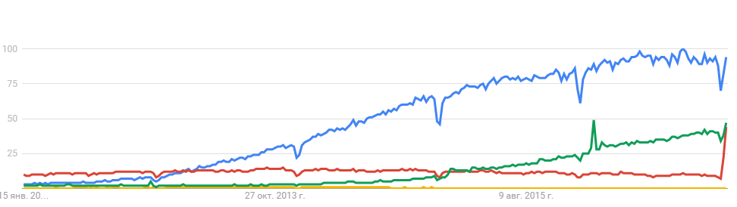
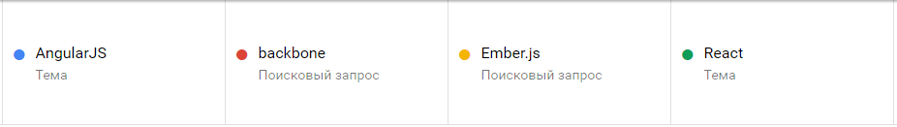
Google Trends

Slide 185
Templates
Angular и Ember включают движок шаблонов. А Backbone оставляет его на усмотрение разработчика. Лучший способ протестировать шаблоны – это взять пример кода. Мы возьмём пример форматирования списка в HTML.

Slide 186
AngularJS
У Angular шаблоны – это HTML со связывающими выражениями. Выражения окружены двойными фигурными скобками:
<ul> <li ng-repeat="framework in frameworks" title="{{framework.description}}"> {{framework.name}} </li> </ul>

Slide 187
Backbone.js
Хотя Backbone можно интегрировать с несколькими движками шаблонов, по умолчанию используется Underscore. Но обработка шаблонов с его помощью довольно примитивна, и приходится добавлять код на JS:
<ul> <% _.each(frameworks, function(framework) { %> <li title="<%- framework.description %>"> <%- framework.name %> </li> <% }); %> </ul>

Slide 188
Ember.js
Ember на сегодняшний день использует Handlebars – это расширение популярного движка Mustache. Сейчас разрабатывается новый вариант Handlebars по имени HTMLBars. Handlebars не понимает DOM – он просто работает со строками. HTMLBars будет понимать DOM.
<ul> {{#each frameworks}} <li {{bind-attr title=description}}> {{name}} </li> {{/each}} </ul>

Slide 189
AngularJS Advantages
Двустороннее связывание.
Angular разбивает приложение на блоки нескольких типов: контроллеры, директивы, фабрики, фильтры, сервисы и виды. Они, в свою очередь, разбиваются на модули. У всех блоков – своя роль. Виды занимаются UI, контроллеры – логикой интерфейса, сервисы общаются с бэкендом, директивы позволяют создавать компоненты и расширяют HTML.
Angular написан с учётом тестируемости.

Slide 190
AngularJS disadvantages
Сложность API директив. Особенно запутывает разработчиков концепция трансклюзии, а кроме того есть такие вещи, как компиляция функций, пред- и пост- линкуемые функции, разные виды областей видимости и настройки директив.
Иерархия областей видимости использует прототипное наследование, которое сложно даётся для людей с опытом в Java и C#.
Angular Expressions широко используются в Видах. Этот язык довольно мощный, иногда даже чересчур. Он позволяет создавать сложную логику и проводить операции присваивания и различные подсчёты внутри шаблонов. Размещение логики в шаблонах усложняет тестирование.
На страницах с обилием интерактива Angular начинает тормозить. Не стоит использовать более 2000 связок на одной странице.

Slide 191
Backbone.js Advantages
Backbone – легковесный и не занимает много памяти. Кривая обучения линейная, и у него есть очень мало концепций для понимания (модели/коллекции, виды, пути). Отличная документация, а код простой. Вы даже можете пройтись по всему коду фреймворка, который хорошо документирован, и ознакомиться с ним в течение часа.
На его основе можно строить свои фреймворки. Примеры готовых: Backbone UI, Chaplin, Geppetto, Marionette, LayoutManager, Thorax, Vertebrae. В случае Angular и Ember вам приходится жить с тем, что для вас приготовили разработчики.

Slide 192
Backbone.js disadvantages
Backbone не предоставляет структуры. Это всего лишь набор простых инструментов для создания структуры, и вам нужно заполнить много пустых мест. Конечно, многие из этих мест заполняются сторонними плагинами – но это значит, что вам нужно принять много решений при их выборе. ыбор лучшего решения занимает время – а суть фреймворка в экономии вашего времени.
Нет поддержки двусторонней связанности данных, то есть вам придётся писать много вспомогательного кода для обновления вида при изменениях модели, и для обновления модели при изменениях вида.
Виды в Backbone напрямую манипулируют DOM, поэтому их сложно тестировать и сложнее повторно использовать.

Slide 193
Ember.js Advantages
Ember.js работает по принципу «соглашения вместо настроек». Ember не требует написания вспомогательного кода, он может сам догадаться до многих вещей, например автоматического определения имени пути и контроллера при определении ресурса. Он даже умеет автоматически создавать контроллер для ресурса, если вы его не определите.
Он включает хороший обработчик путей и опциональный слой для работы с данными под названием ember data. У Ember сразу есть модуль для работы с данными, который хорошо интегрируется с бэкендом Ruby-on-Rails или любым API с RESTful JSON.
При разработке Ember внимание уделялось быстродействию. Ваше приложение скорее всего будет грузиться и работать быстрее.

Slide 194
Ember.js disadvantages
API бурно развивался, поэтому содержит устаревший контент и примеры, которые уже не работают. Взгляните на Ember Data Changelog, и вы поймёте, что я имею в виду. Многие ответы на вопросы на StackOverflow уже неактуальны.
Handlebars загрязняют DOM множеством тегов , что не только усложняет HTML, но и может поломать CSS или интеграцию с другими фреймворками вроде jQuery UI Sortable.

Slide 195

THANK YOU!

